Slide 1



Blockchain based Ether Wallet: Revolutionizing Digital Transactions
Blockchain technology has revolutionized digital transactions across the world. Let's dive into the world of Blockchain-based Ether wallets and understand how they are taking digital transactions to a whole new level.
by 25_Aditya Joshi

Slide 2

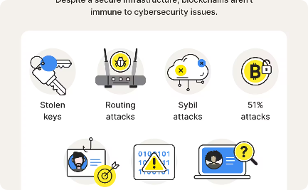
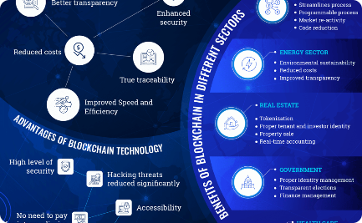
Understanding Blockchain Technology
Decentralized Network
High Level of Security
Unparalleled Benefits
Blockchain technology allows for secure and transparent transactions without the need for a central authority.
All transactions are secured through cryptography and recorded permanently on the blockchain, making it tamper-proof.
From increased transparency to faster transaction speed, blockchain technology has numerous benefits.

Slide 3

Introduction to Ether and Ethereum
Ether
Ether is a cryptocurrency used for transactions on the Ethereum blockchain, with the symbol ETH.
Ethereum
Ethereum is a decentralized open-source blockchain platform that enables the creation of smart contracts and decentralized applications (dApps).
Why it matters
Ether and Ethereum are game-changers as they enable peer-to-peer transactions without the need for any intermediaries like banks or other financial institutions.

Slide 4

What is an Ether Wallet?
1
Definition
An Ether wallet is a software program that allows users to store, send, and receive Ether.
2
Types of Ether Wallets
The two main types of Ether wallets are hardware wallets and software wallets, which include desktop wallets, mobile wallets, and online wallets.
3
Security
Security is a vital aspect of Ether wallets, and users must ensure that their wallets are secured through best practices like two-factor authentication and backups.

Slide 5
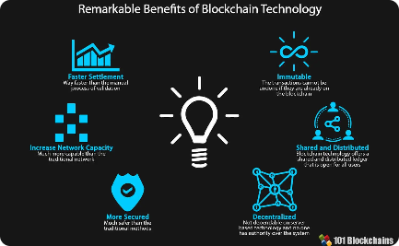
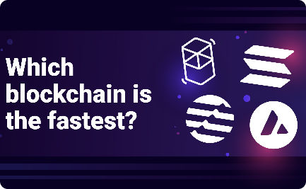

Benefits of a Blockchain based Ether Wallet
Secure Transactions
Fast and Cost-Effective
Increased Transparency
Blockchain-based Ether wallets ensure secure transactions through cryptography and tamper-proof records on the blockchain.
Transactions on the Ethereum blockchain are fast and cost-effective, making them ideal for businesses and individuals alike.
Blockchain technology ensures increased transparency by making all transaction data available on a public and tamper-proof ledger.

Slide 6

Key Features of the Project
1
Smart Contract Integration
The project includes smart contract integration, which enables seamless and transparent transactions.
2
User-Friendly Interface
The user-friendly interface ensures that even non-technical users can easily use the platform.
3
Advanced Security Features
The project includes advanced security features like two-factor authentication and encrypted backups to ensure secure transactions.

Slide 7
Conclusion
Revolutionary Technology
The Future is Bright
Blockchain-based Ether wallets are revolutionizing digital transactions across the world.
As more businesses and individuals understand the benefits of blockchain technology and Ether wallets, the future looks bright for this revolutionary technology.

